Slide 1
Icon
Headline
Buttons for drillthrough
Reset filter
Filter menu
KPI
KPI
KPI
KPI
Solar Energy
⬄
Sunshine / Daylight
(→ monthly)
Solar Energy
⬄
Weather
(→ bars)
Solar Energy
⬄
Imported + Consumed
(→ monthly)
Graph

Slide 2
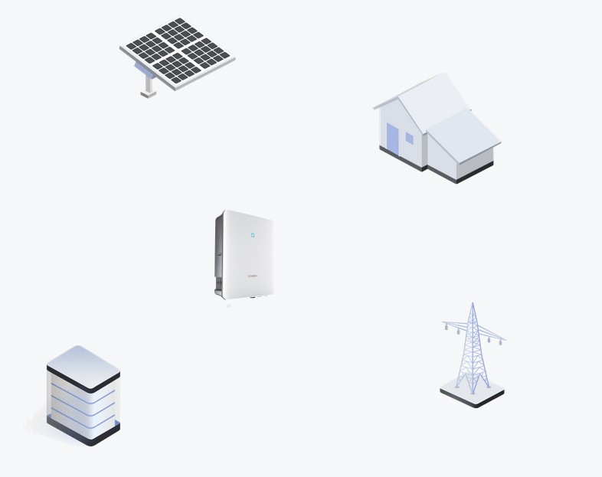
Background for PowerBI

